Slide 1

6th Grade Accelerated
Unit 4, Lesson 5 Perimeter on the Coordinate Plane Volume 1, pg. 159

Slide 2


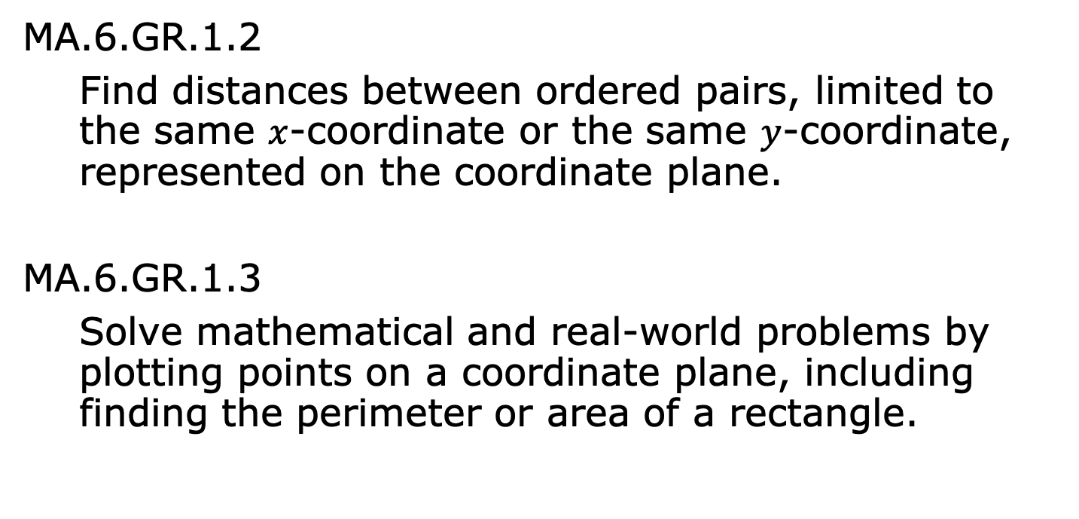
Benchmarks
MA.6.GR.1.2
Find distances between ordered pairs, limited to the same $x$-coordinate or the same $y$-coordinate, represented on the coordinate plane.
MA.6.GR.1.3
Solve mathematical and real-world problems by plotting points on a coordinate plane, including finding the perimeter or area of a rectangle.
volume 1, pg. 159

Slide 3
Integrated Mathematical Thinking and Reasoning Standards
MA.K12.MTR.1.1 Actively participate in effortful learning both individually and collectively.
MA.K12.MTR.4.1 Engage in discussions that reflect on the mathematical thinking of self and others.
MA.K12.MTR.5.1 Use patterns and structure to help understand and connect mathematical concepts.
volume 1, pg. 159

Slide 4

Learning Targets
I can find distances between ordered pairs.
I can find the dimensions of a rectangle on a coordinate plane.
I can find the perimeter of a rectangle on a coordinate plane.
volume 1, pg. 159

Slide 5

Warm-Up
volume 1, pg. 159

Slide 6
4.5.1 Warm-Up: Self-Assessment
Complete each statement to describe your understanding.
how to plot rational number
ordered pairs in all four quadrants.
how to find the perimeter and
area of rectangles.
I know
I need support with
I know
I need support with
volume 1, pg. 159

Slide 7
I know
I need support with
how to find the vertical or
horizontal distance between two ordered pairs that
are located in the same or different quadrants.
volume 1, pg. 159

Slide 8

Guided Instruction
volume 1, pg. 160

Slide 9
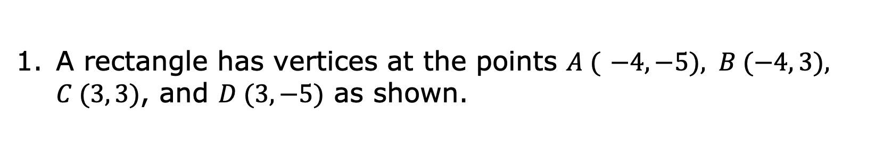
4.5.2 Guided Instruction: Dimensions and Perimeters of Rectangles
A rectangle has vertices at the points $A ($ $−4, −5), B (−4, 3), C (3, 3)$, and $D (3, −5)$ as shown.
volume 1, pg. 160

Slide 10
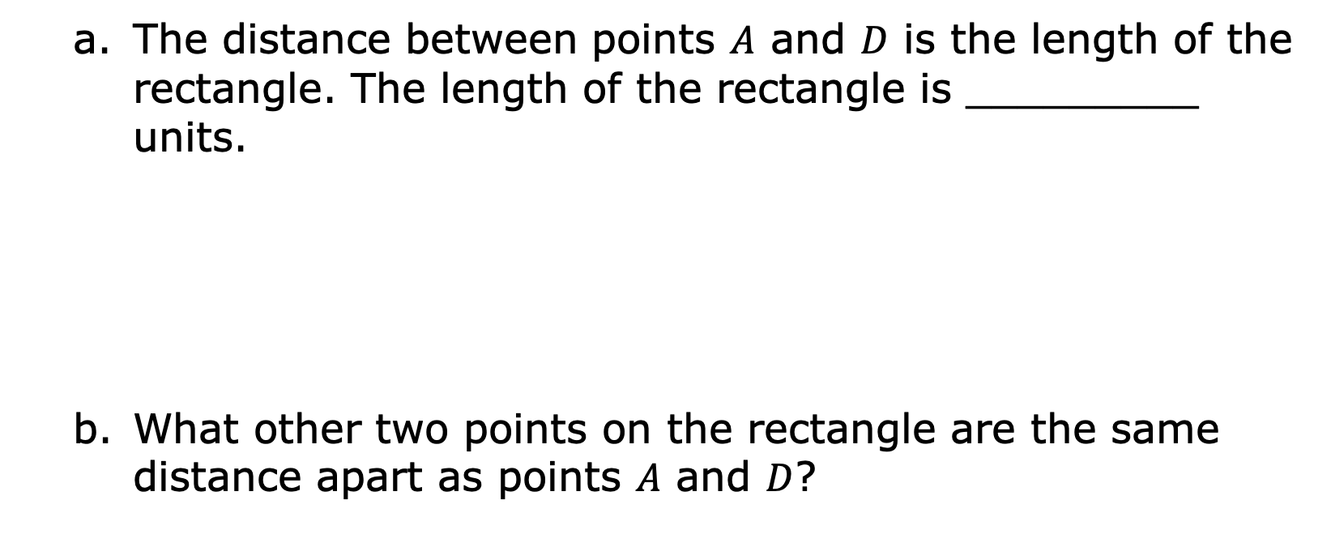
The distance between points $A$ and $D$ is the length of the rectangle. The length of the rectangle is _________ units.
What other two points on the rectangle are the same distance apart as points $A$ and $D$?
volume 1, pg. 160

Slide 11
Between which two points is the line segment that represents the width of the rectangle?
Find the width of the rectangle.
volume 1, pg. 160

Slide 12
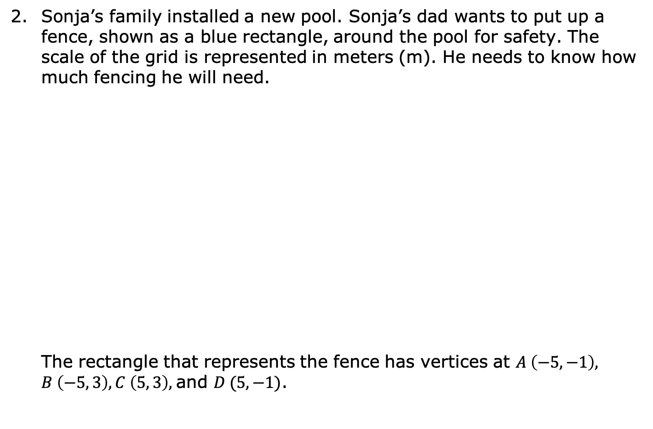
Sonja’s family installed a new pool. Sonja’s dad wants to put up a fence, shown as a blue rectangle, around the pool for safety. The scale of the grid is represented in meters (m). He needs to know how much fencing he will need.
The rectangle that represents the fence has vertices at $A \left(−5, −1\right), B \left(−5, 3\right), C \left(5, 3\right),$and $D (5, −1)$.
volume 1, pg. 161

Slide 13
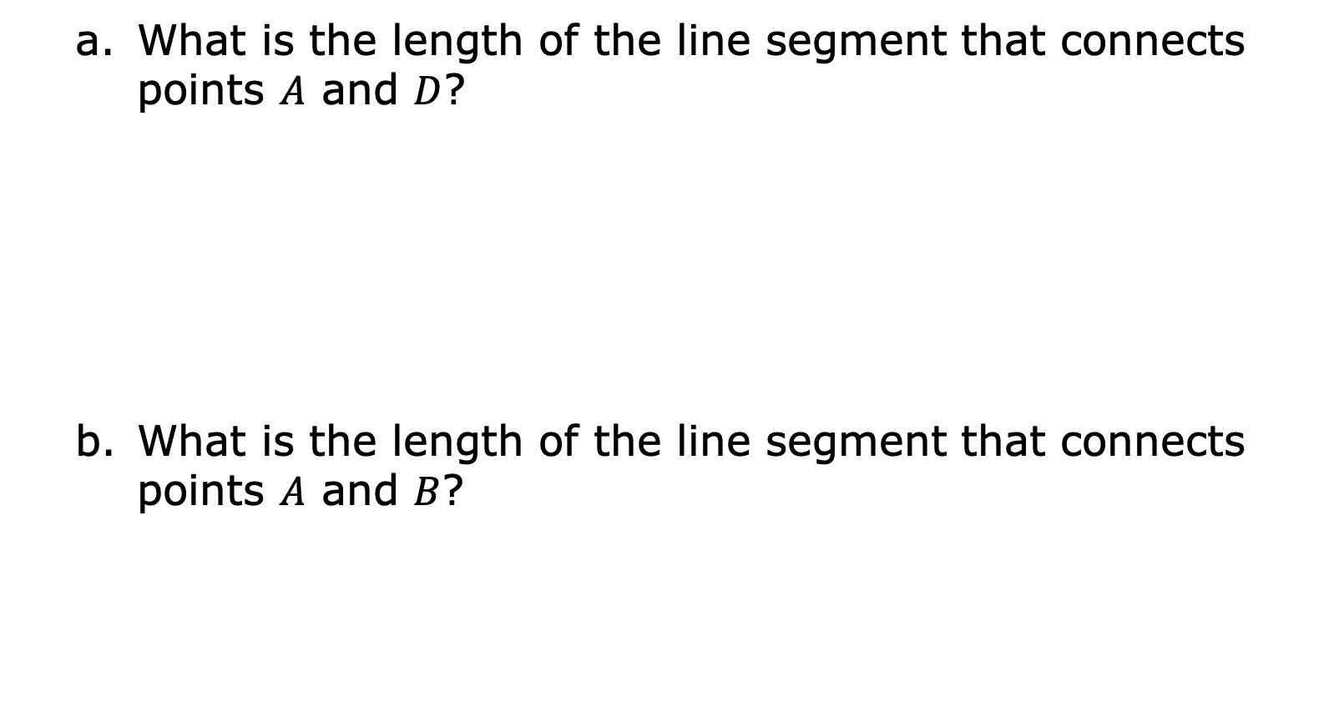
What is the length of the line segment that connects points $A$ and $D$?
What is the length of the line segment that connects points $A$ and $B$?
volume 1, pg. 161

Slide 14
Explain how to calculate the perimeter of the fence.
What is the perimeter of the fence in meters?
volume 1, pg. 161

Slide 15

Try It
volume 1, pg. 162

Slide 16

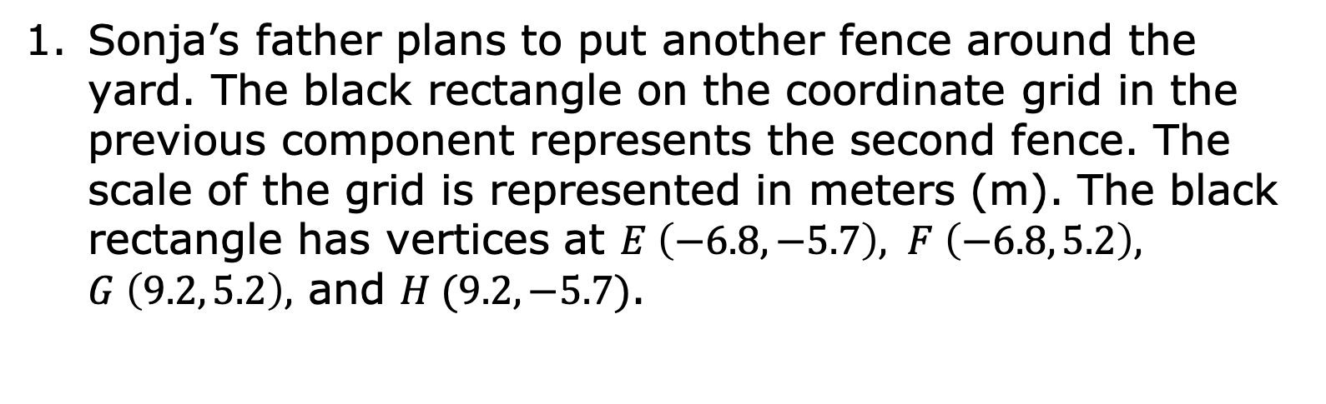
4.5.3 Try It: Perimeter on the Coordinate Plane
Sonja’s father plans to put another fence around the yard. The black rectangle on the coordinate grid in the previous component represents the second fence. The scale of the grid is represented in meters (m). The black rectangle has vertices at $E \left(−6.8, −5.7\right), F \left(−6.8, 5.2\right), G \left(9.2, 5.2\right),$ and $H (9.2, −5.7)$.
volume 1, pg. 162

Slide 17
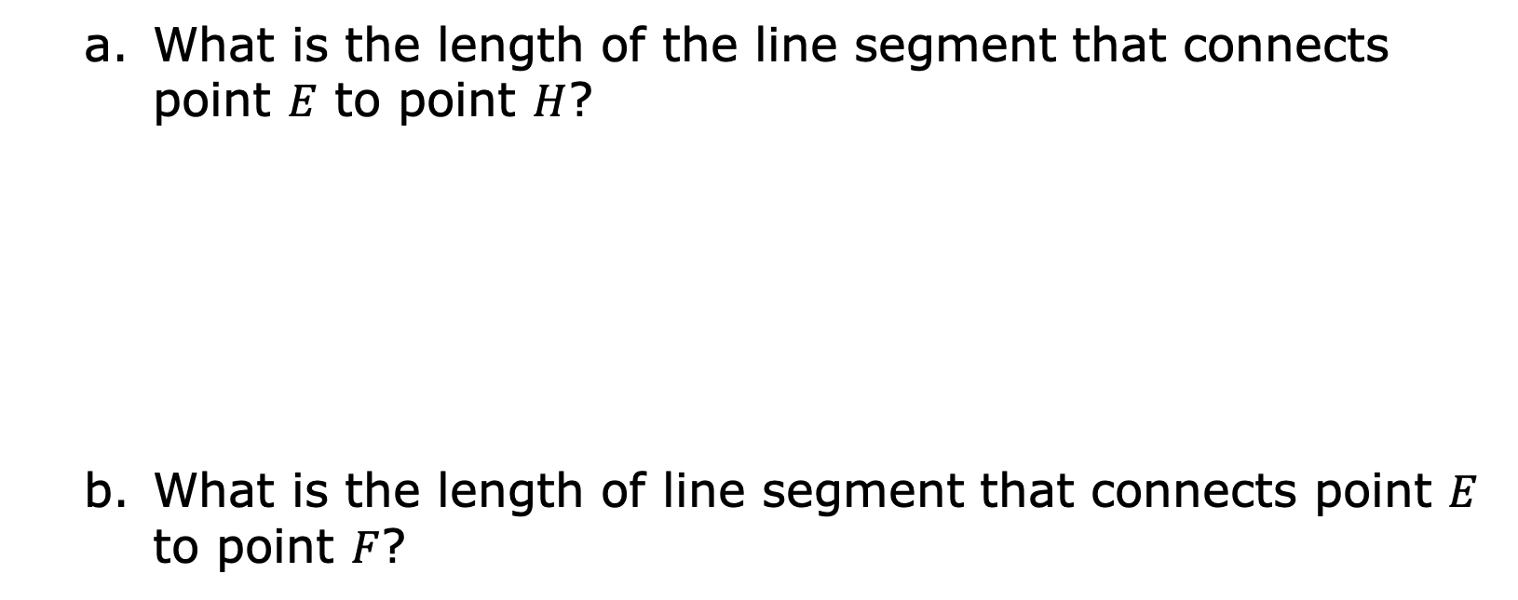
What is the length of the line segment that connects point $E$ to point $H$?
What is the length of line segment that connects point $E$ to point $F$?
volume 1, pg. 162

Slide 18
Determine the perimeter of the fence around the yard.
volume 1, pg. 162

Slide 19

Collaboration
volume 1, pg. 162

Slide 20

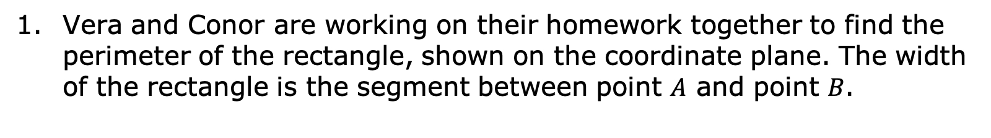
4.5.4 Collaboration: Fix the Mistake
Vera and Conor are working on their homework together to find the perimeter of the rectangle, shown on the coordinate plane. The width of the rectangle is the segment between point $A$ and point $B$.
volume 1, pg. 162

Slide 21
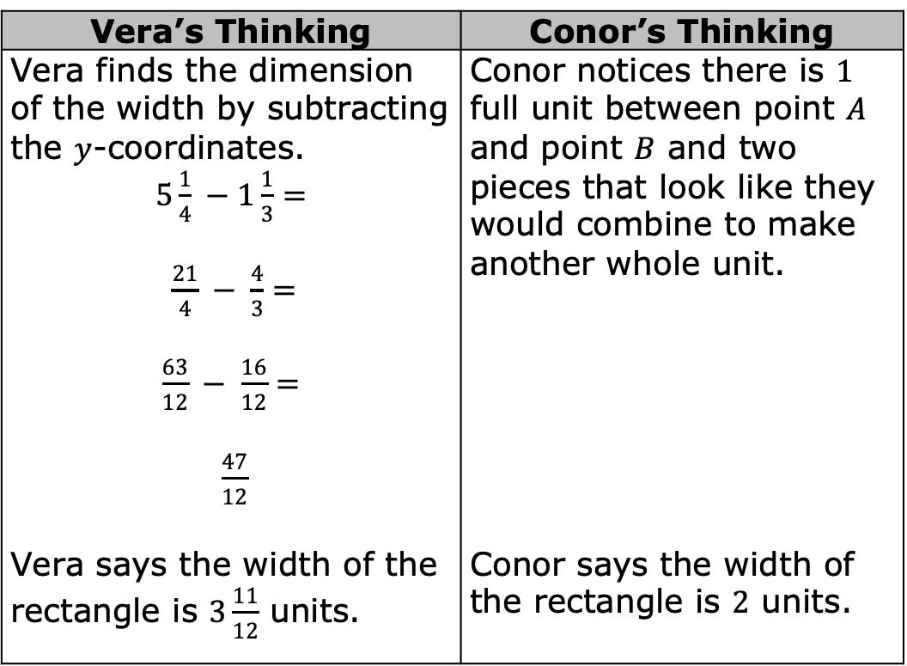
Conor counts the units between the numbers, while Vera determines the dimensions by subtracting. Each student’s work and answers are shown.
Vera’s Thinking | Conor’s Thinking
Vera finds the dimension of the width by subtracting the $y$-coordinates. $5\frac{1}{4} −1\frac{1}{3}=$ $\frac{21}{4} − \frac{4}{3}=$ $\frac{63}{12} − \frac{16}{12}=$ $\frac{47}{12}$ | Conor notices there is $1$ full unit between point $A$ and point $B$ and two pieces that look like they would combine to make another whole unit.
Vera says the width of the rectangle is $3\frac{11}{12}$ units. | Conor says the width of the rectangle is $2$ units.
volume 1, pg. 163

Slide 22
Discuss each student’s work with your partner. Explain any errors that either student made.
volume 1, pg. 163

Slide 23
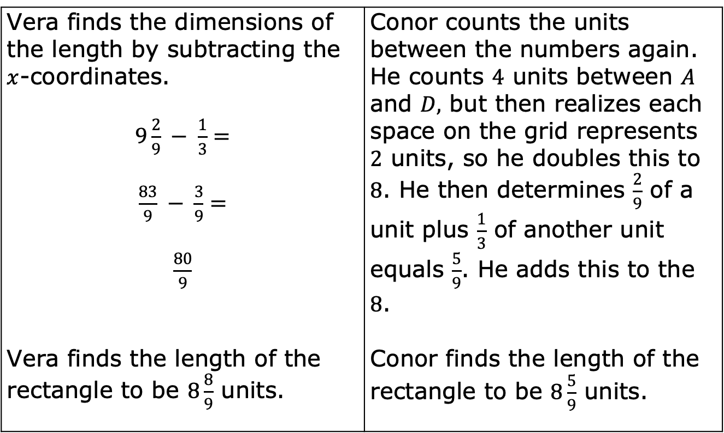
The length of the rectangle is the segment between point $A$ and point $D$.
Vera finds the dimensions of the length by subtracting the $x$-coordinates. $9\frac{2}{9} − \frac{1}{3}=$ $\frac{83}{9} − \frac{3}{9}=$ $\frac{80}{9}$ | Conor counts the units between the numbers again. He counts $4$ units between $A$ and $D,$ but then realizes each space on the grid represents $2$ units, so he doubles this to $8$. He then determines $\frac{2}{9}$ of a unit plus $\frac{1}{3}$ of another unit equals $\frac{5}{9}$. He adds this to the $8$.
Vera finds the length of the rectangle to be $8\frac{8}{9}$ units. | Conor finds the length of the rectangle to be $8\frac{5}{9}$ units.
volume 1, pg. 163

Slide 24
Discuss each student’s work with your partner. Explain any errors that either student made.
volume 1, pg. 163

Slide 25
After collaborating with each other and understanding their mistakes, Vera and Conor each correctly find the perimeter of the rectangle. What perimeter did they find?
volume 1, pg. 163

Slide 26

Your Turn
volume 1, pg. 164

Slide 27
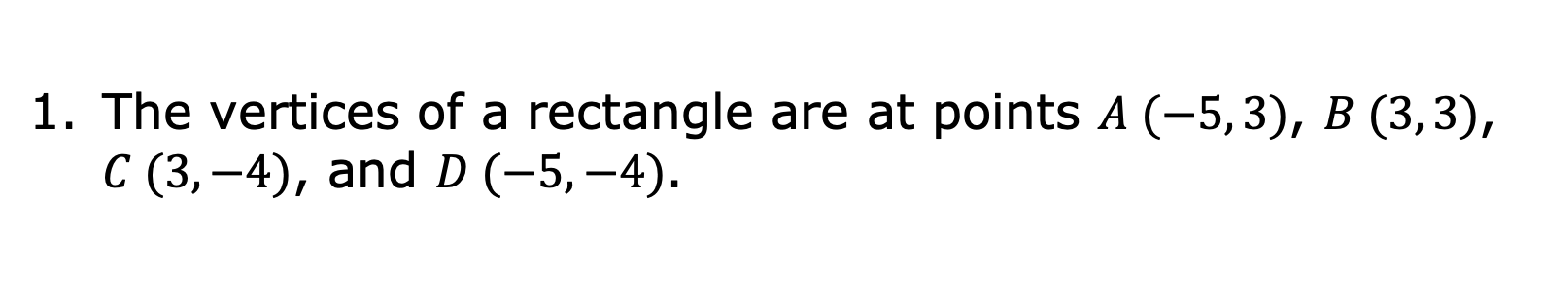
4.5.5 Your Turn!
The vertices of a rectangle are at points $A (−5, 3)$, $B (3, 3)$, $C (3, −4)$, and $D (−5, −4)$.
volume 1, pg. 164

Slide 28
What is the length, in units, of the rectangle?
What is the width, in units, of the rectangle?
What is the perimeter, in units, of the rectangle?
volume 1, pg. 164

Slide 29

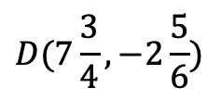
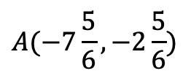
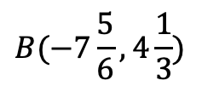
Titus wants to put a border around the outside of his garden.
$$B(−7\frac{5}{6}, 4\frac{1}{3})$$
$$C(7\frac{3}{4}, 4\frac{1}{3})$$
$$A(−7\frac{5}{6}, −2\frac{5}{6})$$
$$D(7\frac{3}{4}, −2\frac{5}{6})$$
volume 1, pg. 164

Slide 30
If the scale of the grid is in feet (ft), how many feet of border will he need to buy to completely fence in the garden?
volume 1, pg. 164

Slide 31

Wrap-Up
volume 1, pg. 165

Slide 32
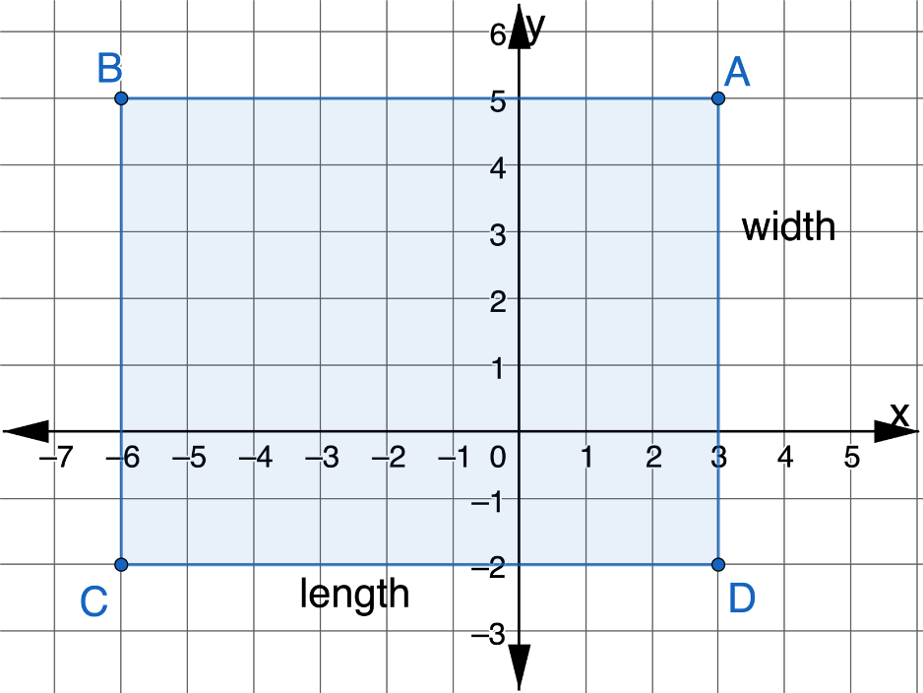
4.5.6 Wrap-Up: Ticket Out the Door
A rectangle is shown on the coordinate plane.
volume 1, pg. 165

Slide 33
What is the length, in units, of the rectangle?
What is the width, in units, of the rectangle?
What is the perimeter, in units, of the rectangle?
volume 1, pg. 165

